Slide 1

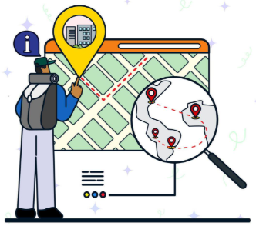
“Title: - Personalized Tourism Recommender using Hybrid Filtering.”
Presented By:
1. Vikhe Harshal
2.Vile Aditya
3.Sudke Krushna
4.Waghmode Atul
5.Randhe Abhishek
Guided By:
Prof. A.A.Pund

Slide 2

Contents
Problem Statement
Abstract
Introduction, Purpose, Scope, Objective
Literature Survey
System Overview Proposed System and Proposed Outcome
System Architecture Diagram & Design DFD Diagrams (Level 0, Level 1)
Hardware and Software Required.

Slide 3
Problem Statement
Tourists often face difficulty in choosing the best destinations or services due to the large volume of options and scattered reviews. Current recommendation systems mostly rely on single techniques, which may lead to less accurate suggestions.
There is no combined approach that uses multiple filtering and sentiment analysis for personalized travel recommendations. This project aims to solve this problem by creating a hybrid tourism recommender system for better and more reliable suggestions.

Slide 4
Abstract
This project proposes a Smart Tourism Recommender System using a hybrid model that integrates User-Based Collaborative Filtering (UBCF), Demographic Filtering (DF), Aspect-Based Sentiment Analysis (ABSA), and Content-Boosted Collaborative Filtering (CBCF).
The system collects and analyzes historical data such as items, users, ratings, and reviews of tourist places like temples, historical spots, and picnic locations. Developed as a Java-based web application, it provides tourists with more accurate, relevant, and personalized recommendations.

Slide 5
Introduction
With the rapid growth of tourism information online, tourists find it hard to choose suitable destinations or services. Traditional recommendation systems are limited to one type of filtering and cannot fully capture user preferences.
This project introduces a smart tourism recommender system that uses a hybrid model to combine various filtering and sentiment analysis techniques. This results in highly personalized and improved travel recommendations for users.

Slide 6
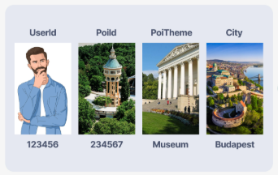
Purpose
The purpose of this project is to develop a reliable and intelligent tourism recommendation system that offers more accurate suggestions to tourists. By combining multiple filtering techniques and sentiment analysis, the system will provide better insights into user preferences and help them choose destinations easily and confidently.

Slide 7
Scope of Project
The project will be implemented as a Java-based web application that collects and analyzes tourism data like places, reviews, and ratings. It will cover historical spots, temples, and picnic places, offering tailored recommendations to users. The scope also includes integrating user reviews and ratings to improve the accuracy of the system and potentially extend it to hotels, restaurants, and transport services.

Slide 8
Objectives
Objectives of Project:
To develop a hybrid recommendation model combining UBCF, DF, ABSA, and CBCF to provide accurate and personalized travel suggestions to users.
To collect and process tourism data such as user profiles, ratings, and reviews of historical places, temples, and picnic spots for better analysis.
To provide personalized recommendations to tourists based on their interests, demographics, and previous behaviors.
To apply Aspect-Based Sentiment Analysis (ABSA) to extract sentiments from user reviews and improve the reliability of recommendations.
To design a simple and user-friendly Java web interface for tourists to easily access and view personalized travel suggestions.
To ensure scalability of the system so it can be extended to include hotels, restaurants, and transport services in the future.

Slide 9
Literature Survey
Sr. No. | Authors | Publication | Description
01 | S. Migliorini, D. Carra, and A. Belussi | IEEE 2021 | Distributing tourists among POIs with an adaptive trip recommendation system.
02 | P. Yochum, L. Chang, T. Gu, and M. Zhu | IEEE 2020 | Linked open data in location-based recommendation system on tourism domain: A survey.
03 | X. Chen, Q. Liu, and X. Qiao | IEEE 2020 | Approaching another tourism recommender.
03 | X. Su, G. Sperlì, V. Moscato, A. Picariello, C. Esposito, and C. Choi | IEEE 2019 | An edge intelligence empowered recommender system enabling cultural heritage applications.
04 | A. Reyes-Menendez, J. R. Saura, and J. G. Martinez-Navalon | IEEE 2019 | The impact of e-WOM on hotels management reputation: Exploring TripAdvisor review credibility with the ELM model.

Slide 10
Proposed System
The proposed system is a Java-based web application that integrates multiple filtering and sentiment analysis methods. It gathers data on tourist spots, user ratings, and reviews, then applies the hybrid model to generate highly accurate recommendations. The system will display personalized travel suggestions for temples, historical locations, and picnic spots in a simple, easy-to-use interface.

Slide 11
Proposed Outcome
The expected outcome is a smart and reliable tourism recommender platform that helps users quickly find the best tourist destinations and services. It will provide personalized, accurate, and relevant suggestions using a hybrid model. This will improve user experience, save time, and enhance satisfaction in planning travel activities.

Slide 12
System Architecture Diagram

Slide 13
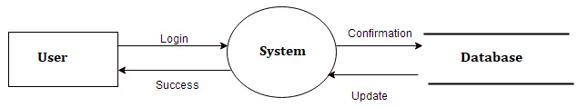
Data Flow Diagrams

Slide 14
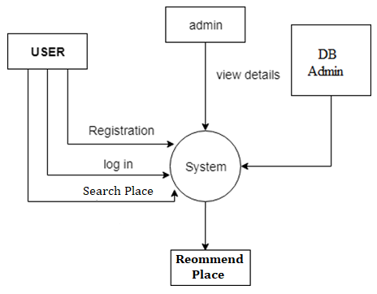
Data Flow Diagrams

Slide 15

Technical Approach
Hardware Requirements:
System : Intel Core i3 2.40GHz.
Hard Disk : 256 GB (Min)
IO Devices : Mouse, Keyboard.
Device Type : Laptop or Computer
Ram : 4 GB (Min).

Slide 16
Technical Approach (Cont…)
Software Requirements:
Operating System : Windows XP/7/LINUX.
Front End : HTML, CSS, .js
Back End : MySQL 5.5
Tool/IDE : Eclipse Kepler
Language : Java (J2EE)

Slide 17


